Slide 1

Systems of Equations and
Inequalities
Copyright © Cengage Learning. All rights reserved.

Slide 2


10.3
Matrices and Systems Of Linear Equations
Copyright © Cengage Learning. All rights reserved.

Slide 3
Objectives
Matrices
The Augmented Matrix of a Linear System
Elementary Row Operations
Gaussian Elimination

Slide 4
Objectives
Gauss-Jordan Elimination
Inconsistent and Dependent Systems
Modeling with Linear Systems

Slide 5
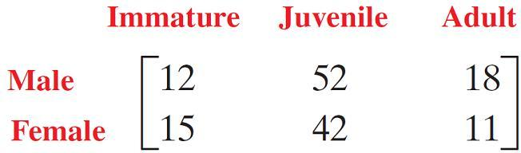
Matrices and Systems Of Linear Equations
A matrix is simply a rectangular array of numbers. Matrices are used to organize information into categories that correspond to the rows and columns of the matrix.
For example, a scientist might organize information on a population of endangered whales as follows:

Slide 6
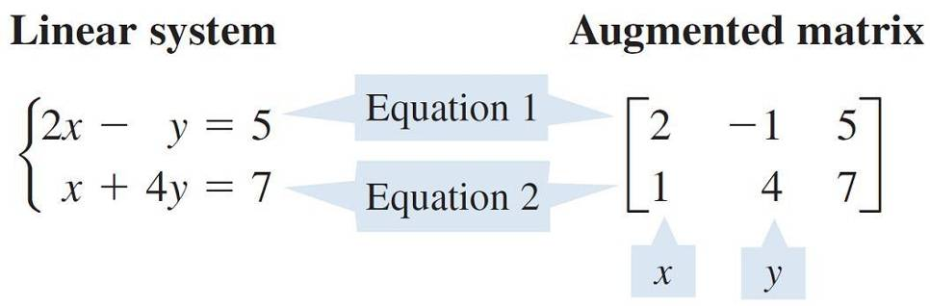
Matrices and Systems Of Linear Equations
In this section we represent a linear system by a matrix, called the augmented matrix of the system:
The augmented matrix contains the same information as the system, but in a simpler form.
The operations we learned for solving systems of equations can now be performed on the augmented matrix.

Slide 7
Matrices

Slide 8
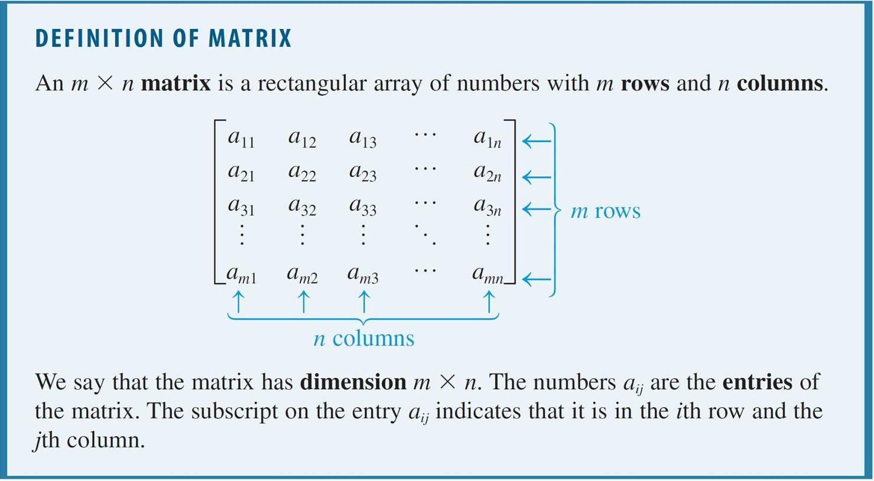
Matrices
We begin by defining the various elements that make up a matrix.

Slide 9
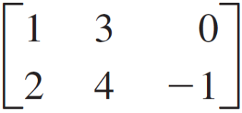
Matrices
Here are some examples of matrices.
Matrix Dimension
2 × 3
[6 –5 0 1] 1 × 4
2 rows by 3 columns
1 row by 4 columns

Slide 10
The Augmented Matrix
of a Linear System

Slide 11
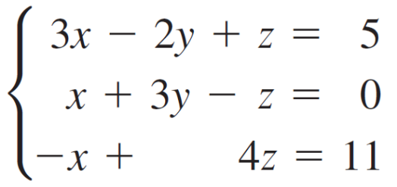
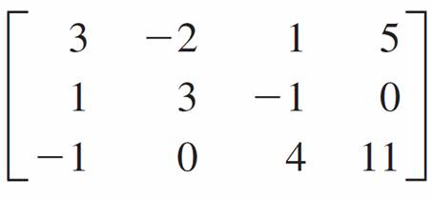
The Augmented Matrix of a Linear System
We can write a system of linear equations as a matrix, called the augmented matrix of the system, by writing only the coefficients and constants that appear in the equations.
Here is an example.
Linear system Augmented matrix
Notice that a missing variable in an equation corresponds to a 0 entry in the augmented matrix.

Slide 12
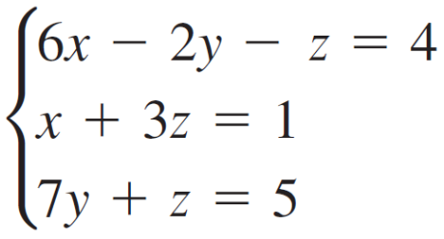
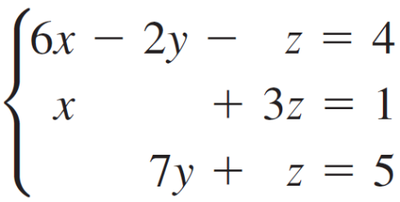
Example 1 – Finding the Augmented Matrix of a Linear System
Write the augmented matrix of the system of equations.
Solution:
First we write the linear system with the variables lined up in columns.

Slide 13
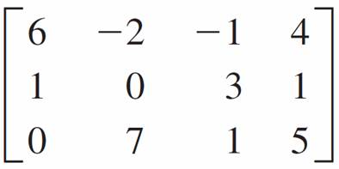
Example 1 – Solution
cont’d
The augmented matrix is the matrix whose entries are the coefficients and the constants in this system.

Slide 14
Elementary Row Operations

Slide 15
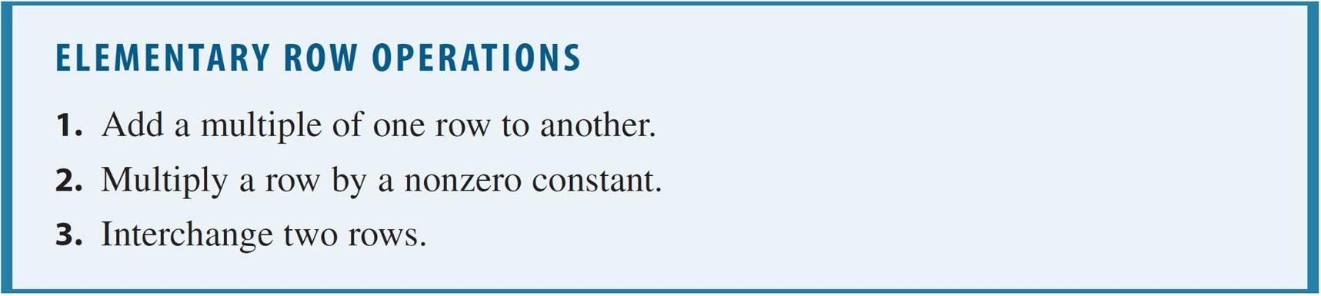
Elementary Row Operations
Note that performing any of these operations on the augmented matrix of a system does not change its solution.

Slide 16
Elementary Row Operations
We use the following notation to describe the elementary row operations:
Symbol Description
R_{i} + kR_{j} → R_{i} Change the ith row by adding k
times row j to it, and then put the
result back in row i.
kR_{i} Multiply the ith row by k.
R_{i} R_{j} Interchange the ith and jth rows.
In the next example we compare the two ways of writing systems of linear equations.

Slide 17
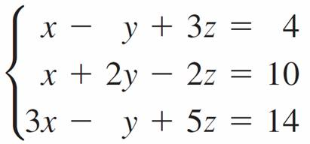
Example 2 – Using Elementary Row Operations to Solve a Linear System
Solve the system of linear equations.
Solution:
Our goal is to eliminate the x-term from the second equation and the x- and y-terms from the third equation.
For comparison, we write both the system of equations and its augmented matrix.

Slide 18
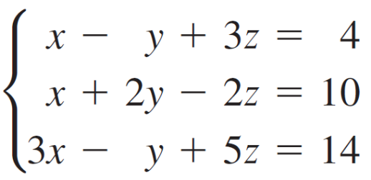
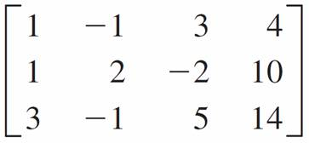
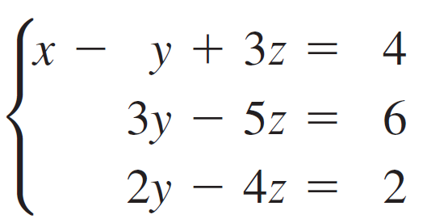
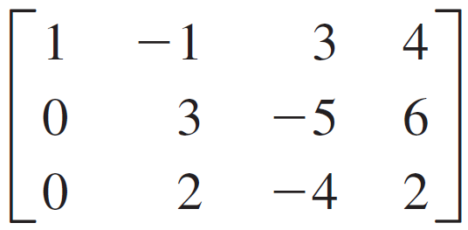
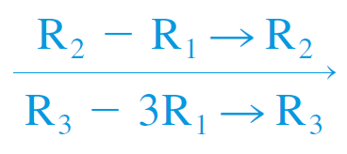
Example 2 – Solution
cont’d
System Augmented matrix
Add (–1) ×
Equation 1 to Equation 2.
Add (–3) ×
Equation 1
to Equation 3.

Slide 19
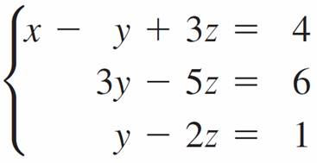
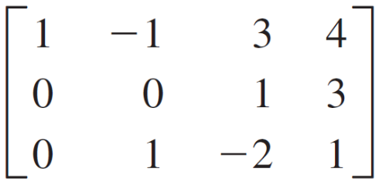

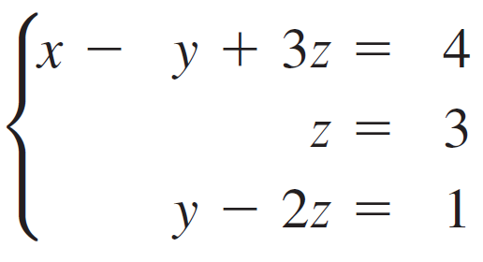
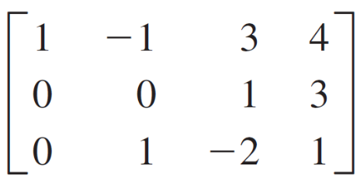
Example 2 – Solution
cont’d
System Augmented matrix
Multiply
Equation 3
by .
Add (–3) ×
Equation 3
to Equation 2
(to eliminate y
from Equation 2).
R₂ – 3R₃ → R₂

Slide 20
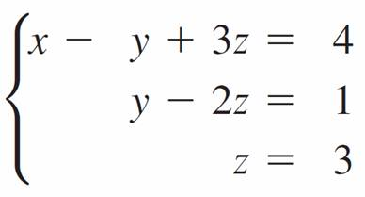
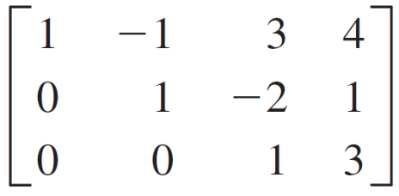
Example 2 – Solution
cont’d
System Augmented matrix
Now we use back-substitution to find that x = 2, y = 7, and
z = 3. The solution is (2, 7, 3).
Interchange
Equations
2 and 3.
R₂ R₃

Slide 21
Gaussian Elimination

Slide 22
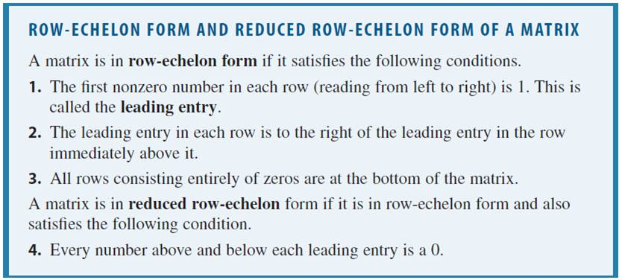
Gaussian Elimination
In general, to solve a system of linear equations using its augmented matrix, we use elementary row operations to arrive at a matrix in a certain form. This form is described in the following box.

Slide 23
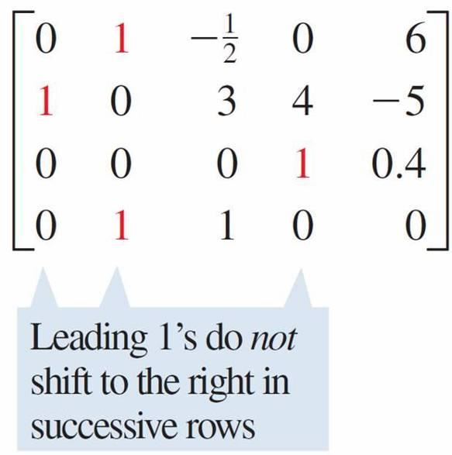
Gaussian Elimination
In the following matrices, the first one is not in row-echelon form.
Not in row-echelon form

Slide 24
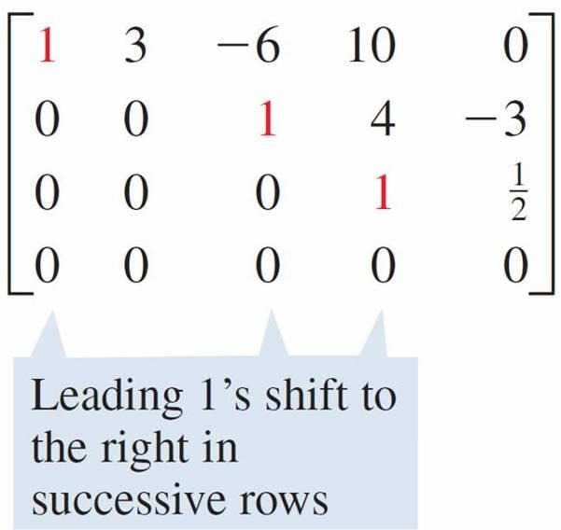
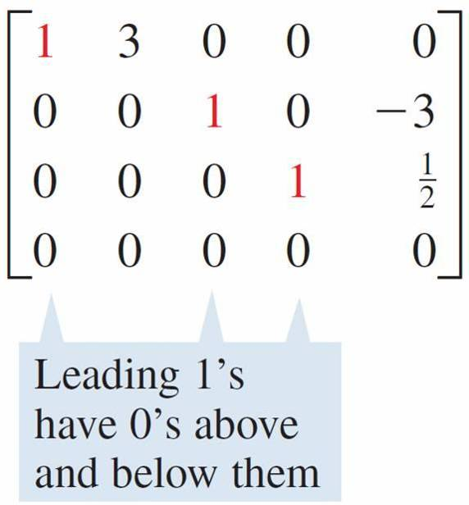
Gaussian Elimination
The second one is in row-echelon form, and the third one is in reduced row-echelon form. The entries in red are the leading entries.
Row-echelon form Reduced row-echelon form

Slide 25
Gaussian Elimination
Here is a systematic way to put a matrix in row-echelon form using elementary row operations:
Start by obtaining 1 in the top left corner. Then obtain
zeros below that 1 by adding appropriate multiples of the
first row to the rows below it.
Next, obtain a leading 1 in the next row, and then obtain
zeros below that 1.

Slide 26
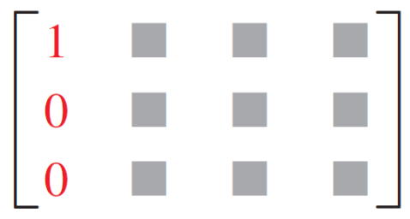
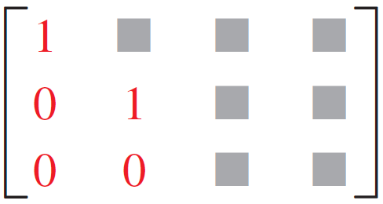
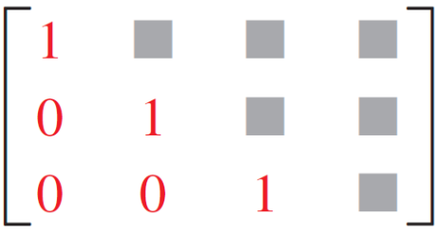
Gaussian Elimination
At each stage make sure that every leading entry is to the
right of the leading entry in the row above it—rearrange
the rows if necessary.
Continue this process until you arrive at a matrix in
row-echelon form.
This is how the process might work for a 3 × 4 matrix:

Slide 27
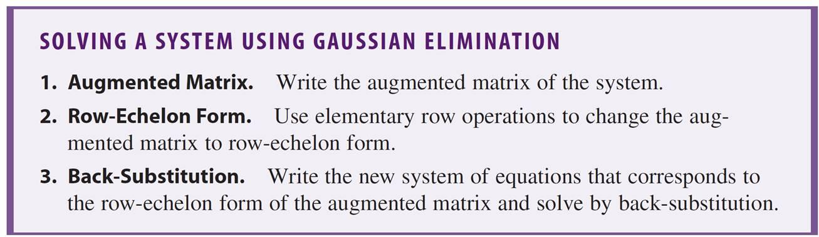
Gaussian Elimination
Once an augmented matrix is in row-echelon form, we can solve the corresponding linear system using back substitution.
This technique is called Gaussian elimination, in honor of its inventor, the German mathematician C. F. Gauss.

Slide 28
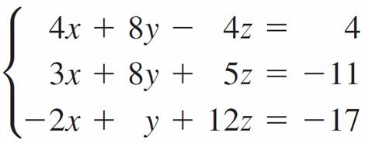
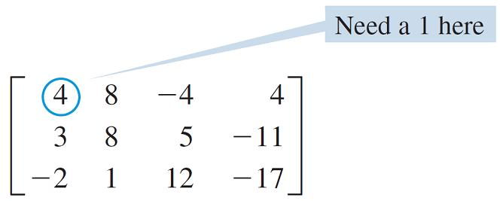
Example 3 – Solving a System Using Row-Echelon Form
Solve the system of linear equations using Gaussian elimination.
Solution:
We first write the augmented matrix of the system, and then we use elementary row operations to put it in row-echelon form.
Augmented matrix:

Slide 29
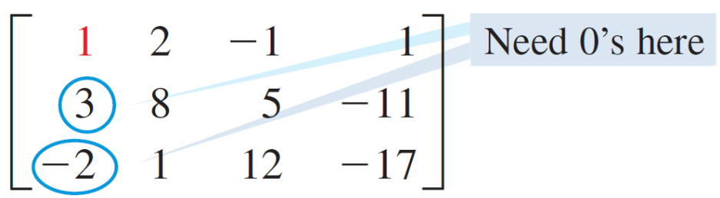

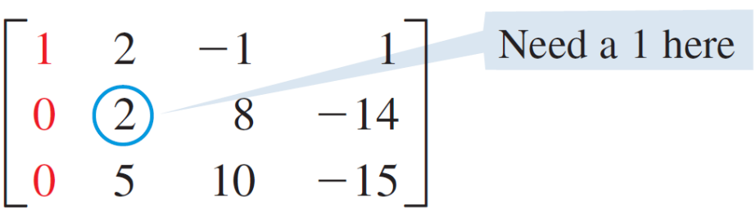
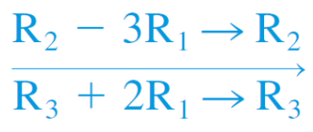
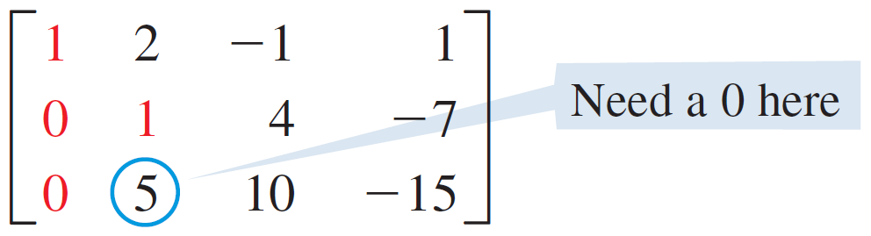

Example 3 – Solution
cont’d

Slide 30
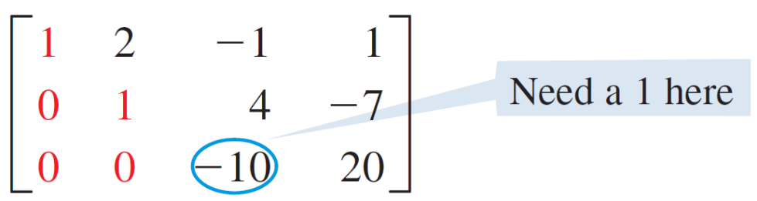
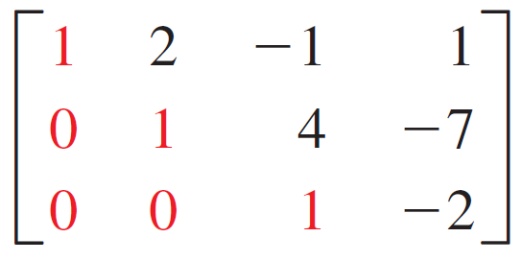

Example 3 – Solution
cont’d
Row-echelon form:
R₃ – 5R₂ → R₃

Slide 31
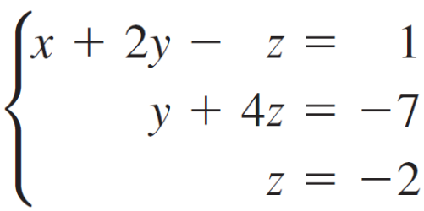
Example 3 – Solution
cont’d
We now have an equivalent matrix in row-echelon form, and the corresponding system of equations is
Back-substitute:
We use back-substitution to solve the system.
y + 2(– 2) = –3
y = 1
Back-substitute z = –2
into Equation 2
Solve for y

Slide 32
Example 3 – Solution
cont’d
Back-substitute y = 1 and
z = –2 into Equation 1
x + 2(1) – (–2) = 1
x = –3
So the solution of the system is (–3, 1, –2).
Solve for x

Slide 33
Gauss-Jordan Elimination

Slide 34
Gauss-Jordan Elimination
If we put the augmented matrix of a linear system in reduced row-echelon form, then we don’t need to back substitute to solve the system.
To put a matrix in reduced row-echelon form, we use the following steps.
Use the elementary row operations to put the matrix in
row-echelon form.
Obtain zeros above each leading entry by adding
multiples of the row containing that entry to the rows
above it. Begin with the last leading entry and work up.

Slide 35
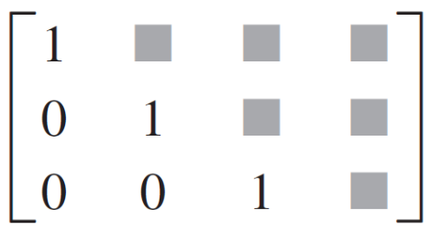
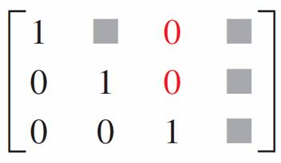
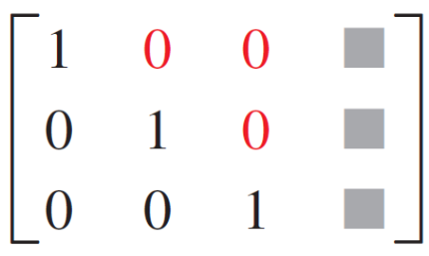
Gauss-Jordan Elimination
Here is how the process works for a 3 × 4 matrix:
→ →
Using the reduced row-echelon form to solve a system is called Gauss-Jordan elimination.
The process is illustrated in the next example.

Slide 36
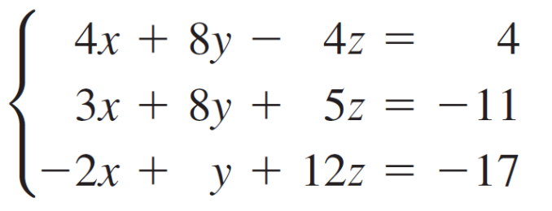
Example 4 – Solving a System Using Reduced Row-Echelon Form
Solve the system of linear equations, using Gauss-Jordan elimination.
Solution:
In Example 3 we used Gaussian elimination on the augmented matrix of this system to arrive at an equivalent matrix in row-echelon form.

Slide 37
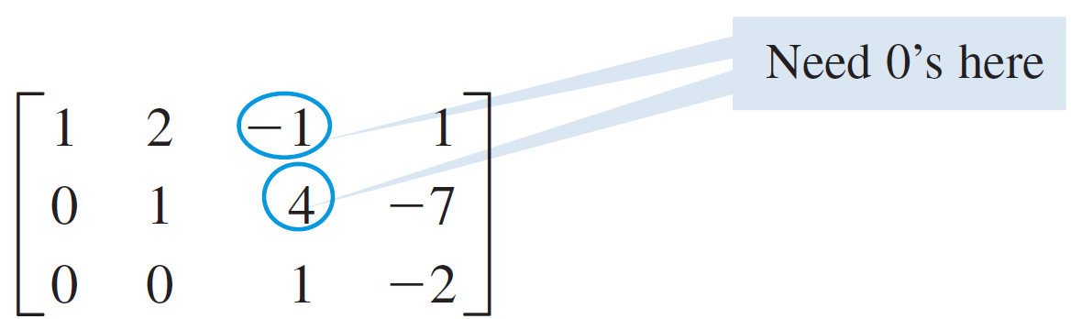
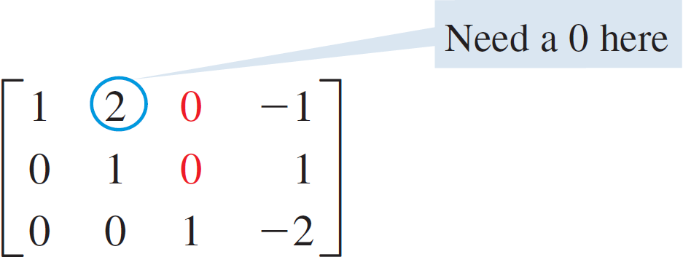
Example 4 – Solution
cont’d
We continue using elementary row operations on the last matrix in Example 3 to arrive at an equivalent matrix in reduced row-echelon form.
R₂ – 4R₃ → R₂
R₁ + R₃ → R₁

Slide 38
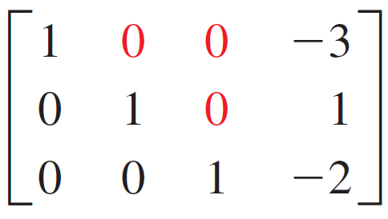
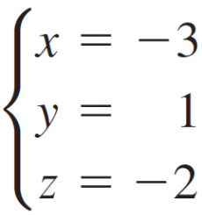
Example 4 – Solution
cont’d
We now have an equivalent matrix in reduced row-echelon form, and the corresponding system of equations is
Hence we immediately arrive at the solution (–3, 1, –2).
R₁ – 2R₂ → R₁

Slide 39
Inconsistent and Dependent Systems

Slide 40
Inconsistent and Dependent Systems
The systems of linear equations that we considered in Examples 1–4 had exactly one solution.
But as we know, a linear system may have one solution, no solution, or infinitely many solutions.

Slide 41
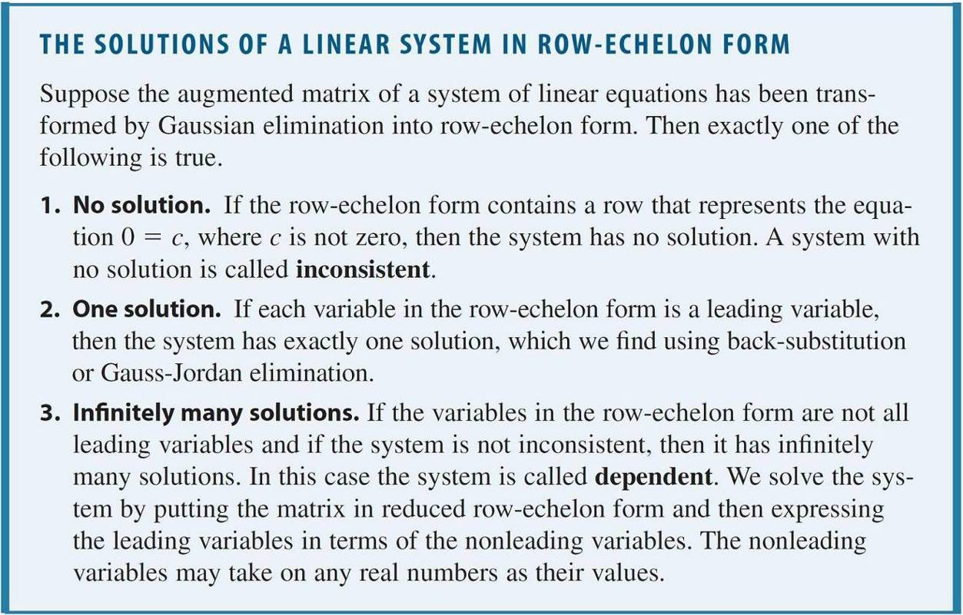
Inconsistent and Dependent Systems
Fortunately, the row-echelon form of a system allows us to determine which of these cases applies, as described in the following box.

Slide 42
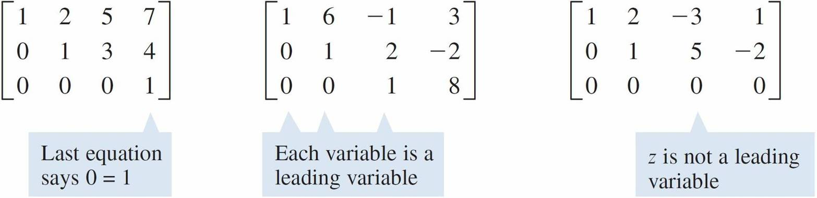
Inconsistent and Dependent Systems
First we need some terminology. A leading variable in a linear system is one that corresponds to a leading entry in the row-echelon form of the augmented matrix of the system.
The matrices below, all in row-echelon form, illustrate the three cases described in the box.
No solution One solution Infinitely many solutions

Slide 43
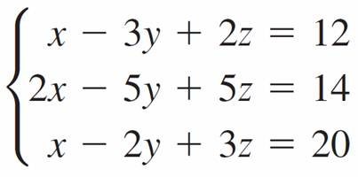


Example 5 – A System with No Solution
Solve the system.
Solution:
We transform the system into row-echelon form.
R₂ – 2R₁ → R₂
R₃ – R₁ → R₃

Slide 44



Example 5 – Solution
cont’d
This last matrix is in row-echelon form, so we can stop the Gaussian elimination process.
Now if we translate the last row back into equation form, we get 0x + 0y + 0z = 1, or 0 = 1, which is false.
No matter what values we pick for x, y, and z, the last equation will never be a true statement. This means that the system has no solution.
R₃ – R₂ → R₃

Slide 45



Example 6 – A System with Infinitely Many Solutions
Find the complete solution of the system.
Solution:
We transform the system into reduced row-echelon form.
R₁ R₃

Slide 46



Example 6 – Solution
cont’d
The third row corresponds to the equation 0 = 0.
This equation is always true, no matter what values are used for x, y, and z. Since the equation adds no new information about the variables, we can drop it from the system.
R₂ + R₁ → R₂
R₃ + 2R₂ → R₃
R₃ + 3R₁ → R₃
R₁ – R₂ → R₁

Slide 47

Example 6 – Solution
cont’d
So the last matrix corresponds to the system
Now we solve for the leading variables x and y in terms of the nonleading variable z:
x = 7z – 5
y = 3z + 1
Equation 1
Equation 2
Solve for x in Equation 1
Solve for y in Equation 2

Slide 48
Example 6 – Solution
cont’d
To obtain the complete solution, we let t represent any real number, and we express x, y, and z in terms of t:
x = 7t – 5
y = 3t + 1
z = t
We can also write the solution as the ordered triple
(7t – 5, 3t + 1, t), where t is any real number.

Slide 49
Modeling with Linear Systems

Slide 50
Modeling with Linear Systems
Linear equations, often containing hundreds or even thousands of variables, occur frequently in the applications of algebra to the sciences and to other fields.
For now, let’s consider an example that involves only three variables.

Slide 51
Example 8 – Nutritional Analysis Using a System of Linear Equations
A nutritionist is performing an experiment on student volunteers. He wishes to feed one of his subjects a daily diet that consists of a combination of three commercial diet foods: MiniCal, LiquiFast, and SlimQuick.
For the experiment it is important that the subject consume exactly 500 mg of potassium, 75 g of protein, and 1150 units of vitamin D every day.

Slide 52

Example 8 – Nutritional Analysis Using a System of Linear Equations
cont’d
The amounts of these nutrients in one ounce of each food are given in the table. How many ounces of each food should the subject eat every day to satisfy the nutrient requirements exactly?

Slide 53
Example 8 – Solution
Let x, y, and z represent the number of ounces of MiniCal, LiquiFast, and SlimQuick, respectively, that the subject should eat every day.
This means that he will get 50x mg of potassium from MiniCal, 75y mg from LiquiFast, and 10z mg from SlimQuick, for a total of 50x + 75y + 10z mg potassium in all.

Slide 54


Example 8 – Solution
cont’d
Since the potassium requirement is 500 mg, we get the first equation below.
Similar reasoning for the protein and vitamin D
requirements leads to the system
Dividing the first equation by 5 and the third one by 10 gives the system
Potassium
Protein
Vitamin D

Slide 55
Example 8 – Solution
cont’d
We can solve this system using Gaussian elimination, or we can use a graphing calculator to find the reduced row echelon form of the augmented matrix of the system.
From the reduced row-echelon form we see that
x = 5, y = 2, z = 10.
The subject should be fed 5 oz of Mini-Cal, 2 oz of LiquiFast, and 10 oz of SlimQuick every day.

Slide 56

Example 8 – Solution
cont’d
Check Your Answer:
x = 5, y = 2, z = 10

